Slide 1
Maslow before Bloom
Prioritising Needs and Wellbeing
self-
actualisation
safety and security
physiological
self-esteem
love and belonging
create
evaluate
understand
remember
analyse
apply
www.suecowley.co.uk / @Sue_Cowley / @suecowley.bsky.social

Slide 2
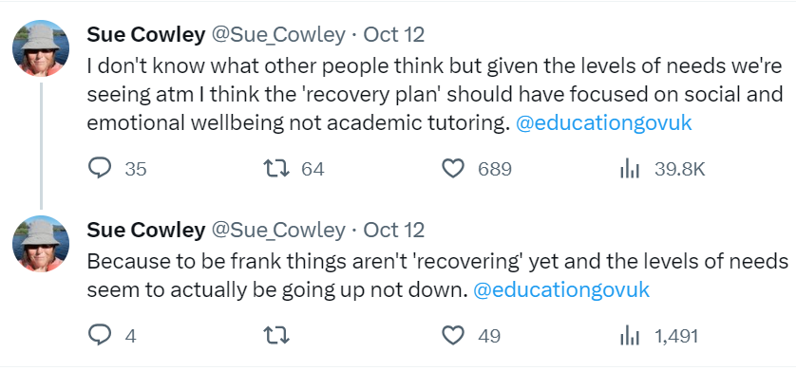

Slide 3
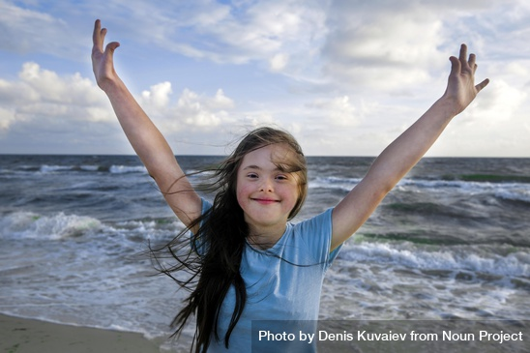
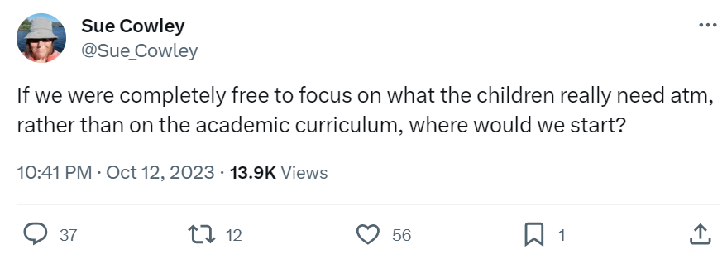

Slide 4
Where would you start?

Slide 5
physiological needs …

Slide 6
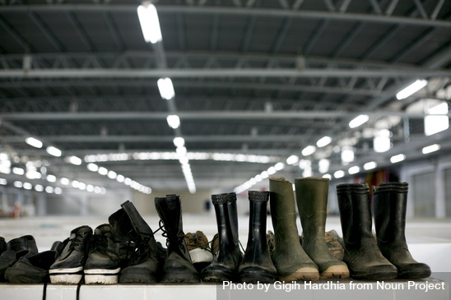
Stand in their shoes
Wellbeing check-in
Self-regulate for agency

Slide 7
safety and security …

Slide 8
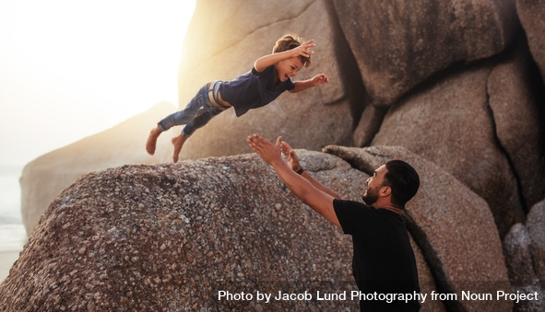
Confident control
Model risk taking
Praise the process

Slide 9
love and belonging …

Slide 10
‘Professional love’
A community of learners
Reboot every time

Slide 11
self-esteem …

Slide 12
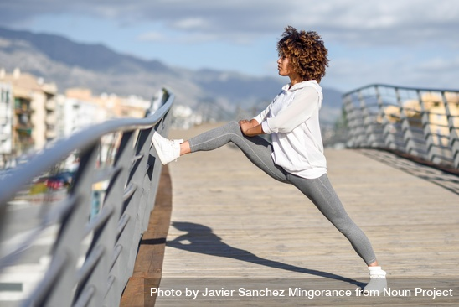
ZPD: comfort/
stretch/panic
I thought
of you
Interests and agency

Slide 13
self-actualisation …

Slide 14
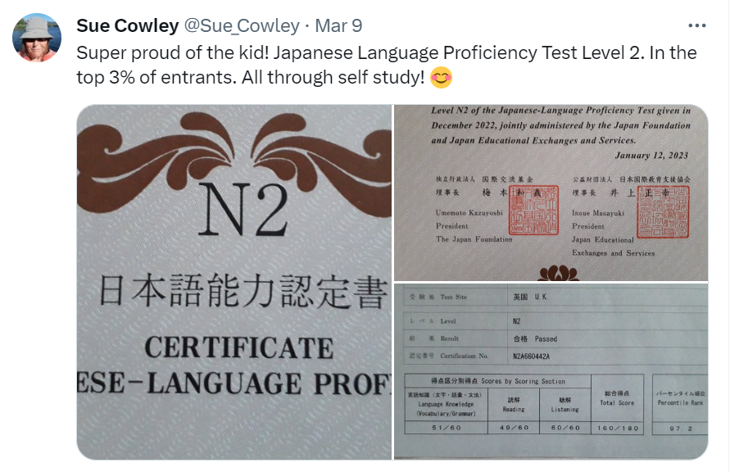

Slide 15
The learner is not for the setting;
the setting is for the learner.

