Slide 1
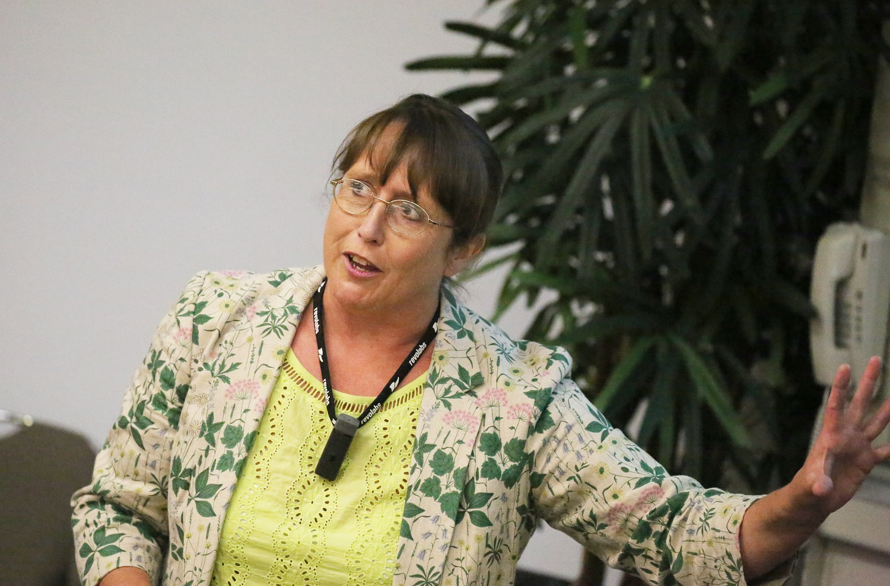
How To Survive your First Year in Teaching
Welcome – you’re in the right place! This webinar will start at 4.30pm
www.suecowley.co.uk
sue@suecowley.co.uk
@Sue_Cowley

Slide 2
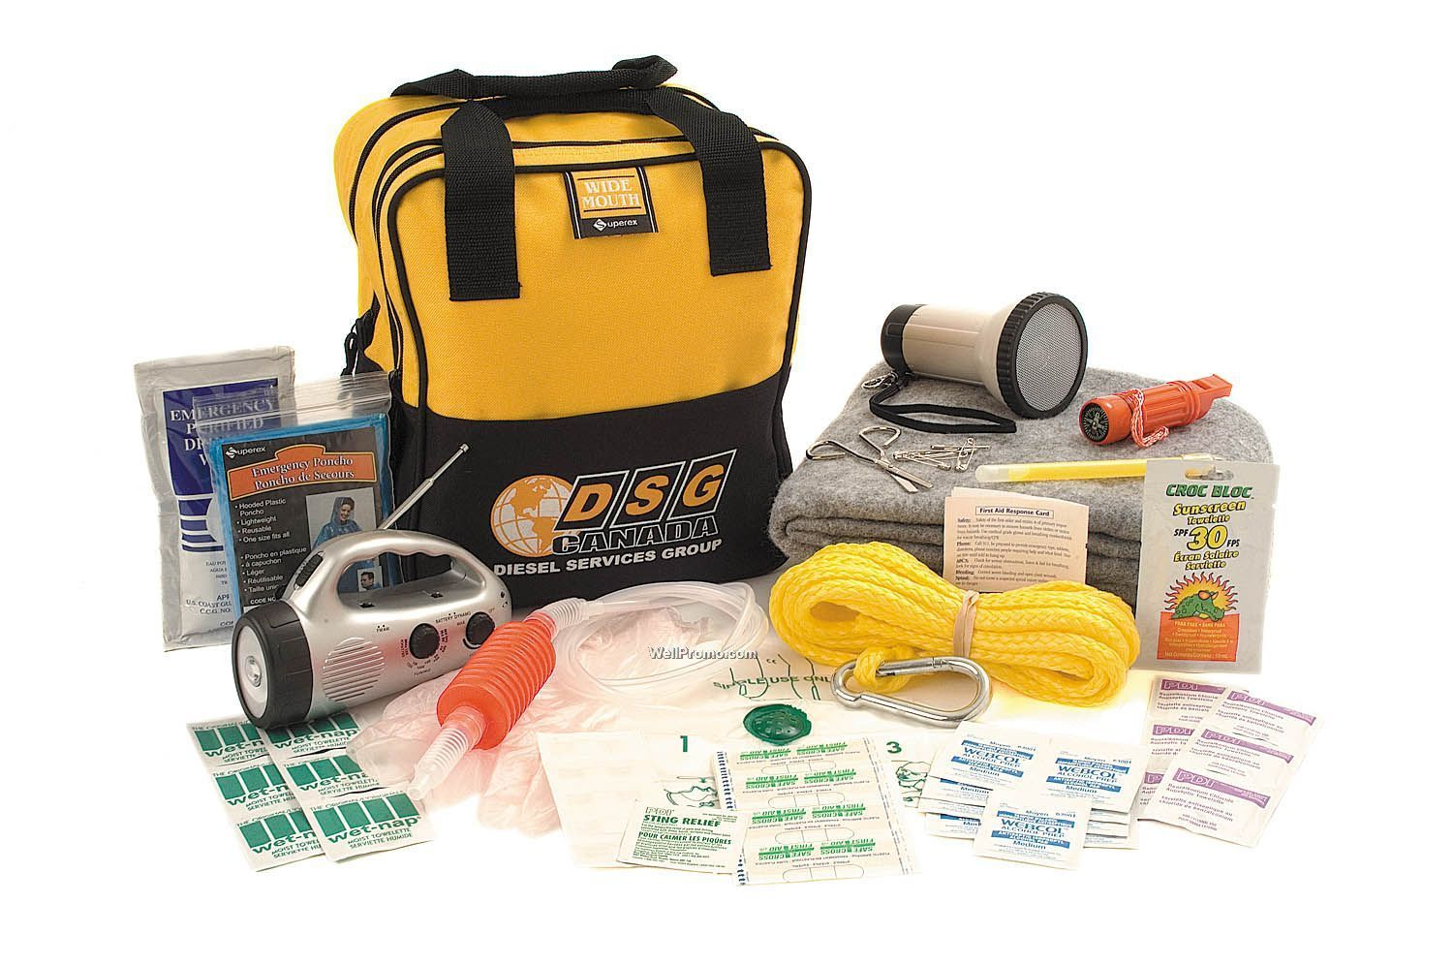
A Survival Kit for your First Year
1. Managing your Time
2. Climbing the Paperwork Mountain
3. Thinking Wellbeing
4. Planning, Marking and Assessment
5. Voice Usage and Voice Care
6. Behaviour and Classroom Management
7. The ECF and the Teachers’ Standards

Slide 3
1. Managing your Time

Slide 4
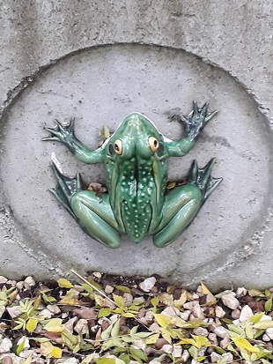
Managing your Time
“Eat the frog”
What is your ‘frog’ at the moment?

Slide 5
Managing your Time
“Good enough is good enough.”

Slide 6
Managing your Time
“The challenge is not to manage time but to manage ourselves.”

Slide 7
Managing your time: the 3 enemies
Procrastination
Perfectionism
Pressure of accountability

Slide 8
Managing your Time
24 hours a day, 7 days a week?
‘Good enough’ is good enough
Do the thing you least want to do first
Give yourself the occasional ‘lesson off’
Prioritise things to do with learning
Plan ahead for report writing

Slide 9
2. Climbing the Paperwork Mountain

Slide 10
Climbing the Paperwork Mountain
Follow the ‘once’ rule
Beware the never ending ‘to do’ list
If in doubt, chuck it out
Pass the buck
Re-use, borrow, magpie

Slide 11
Climbing the Paperwork Mountain
In tray/Inbox options
Deal immediately
File
Bin/Recycle
‘To do’ list
Delegate

Slide 12
Climbing the paperwork mountain
Lost exercise book
Email from parent about bullying
Request for information for TAC meeting
Request for work for excluded child
Agenda for next staff meeting
Lesson observation feedback form
Deal?
To Do?
Delegate?
File?
Bin/Recycle?

Slide 13
the Eisenhower matrix
Urgent Not Urgent
Do first
‘To do’ list
Delegate
Dump
Not Important Important

Slide 14
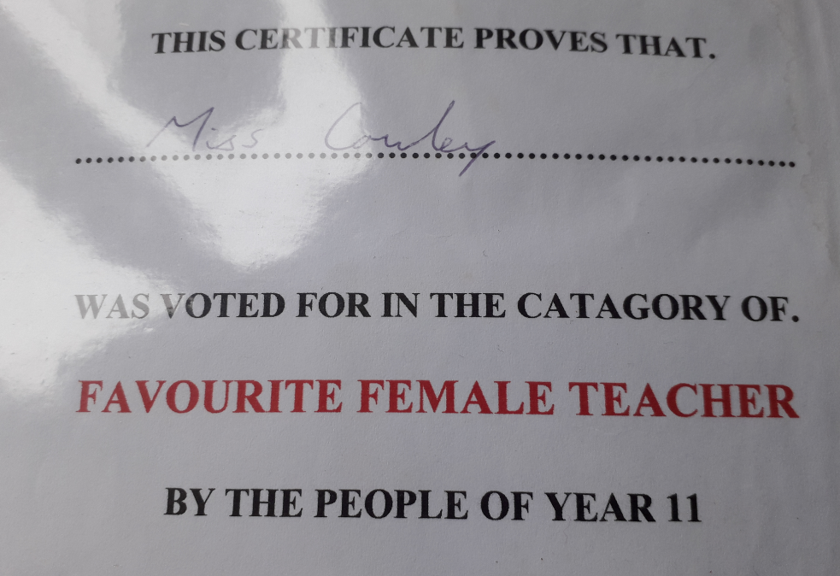
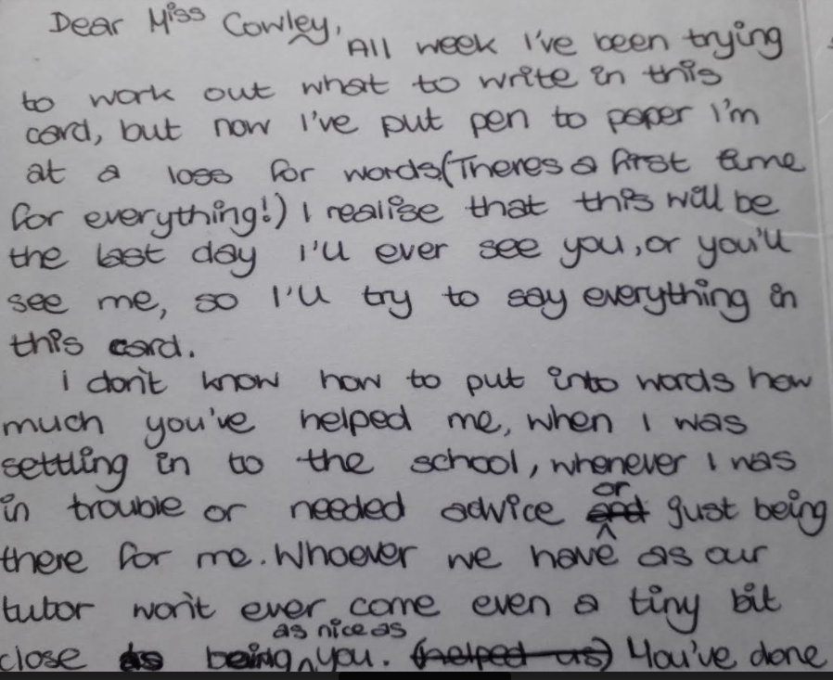
Positive paperwork!

Slide 15
3. Thinking Wellbeing

Slide 16
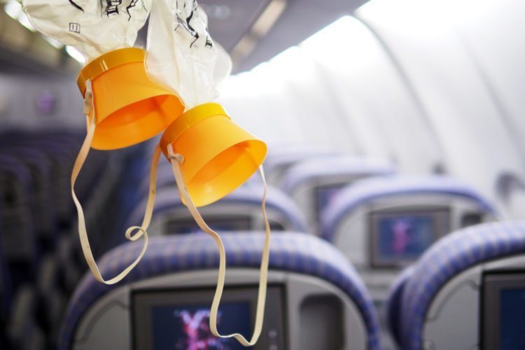
Wellbeing and workload
Learn to forgive yourself
Protect your voice
Practice selfish altruism
Take up a hobby or sport
Aim for ‘work free’ days
February half term holiday

Slide 17
‘lesson off’ ideas
Oral assessment
Group presentations to the class
Computer based tasks
Watching a video related to a topic
Taking a test (peer marked)
Class presentation to parents

Slide 18
Having difficult conversations about workload and wellbeing
Clear goal
Plan, not script
Take on other view
Slow pace, listen
Offer alternative solution
Give something back?

Slide 19
4. Planning, Marking and Assessment

Slide 20
Thinking teaching & learning
Planning
What do I want them to learn?
What is the intended outcome of the lesson (know/do)?
Teaching/Differentiation
Who does most of the work?
How will I meet the needs of the outliers?
Assessment
What did/didn’t they learn?
How can I build on this next lesson?

Slide 21
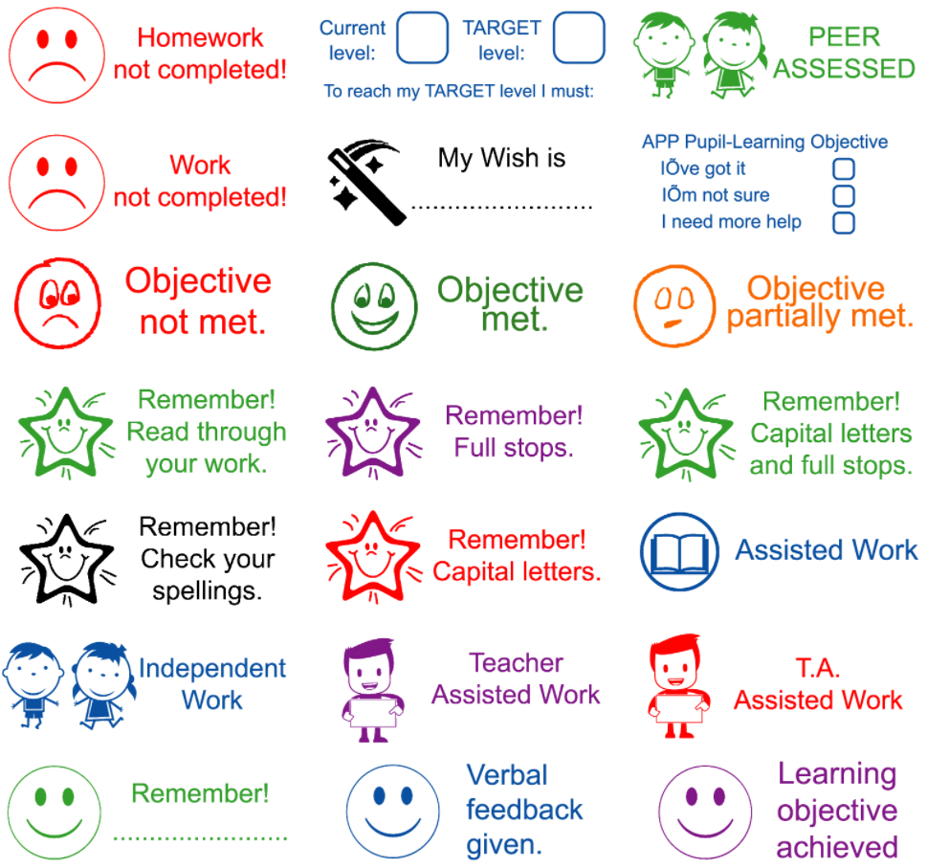
Marking: time saving tips
Pen on a rope/in a pocket
Open on the right page
Self marking
Peer assessment
Stampers
Whole class feedback
Proofreading symbols
‘I will mark for this’ targets

Slide 22
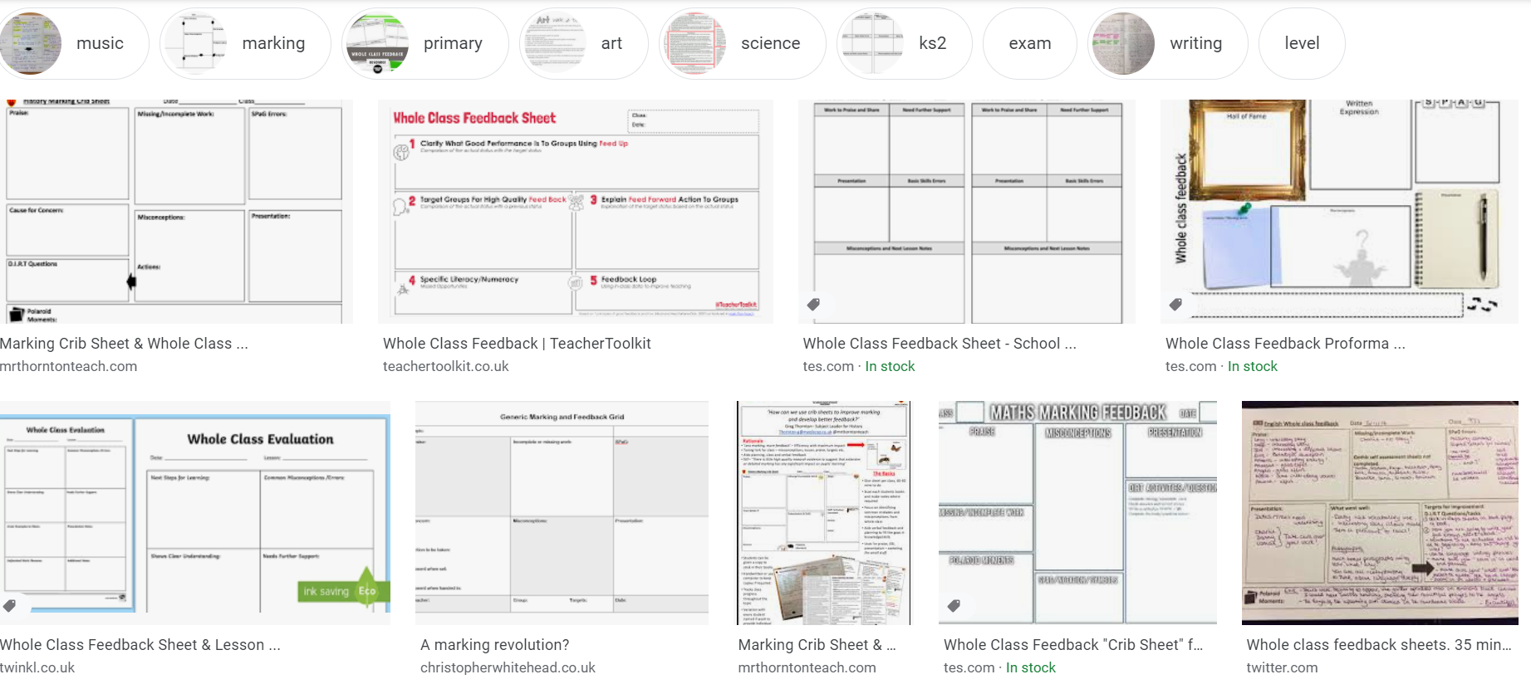
Marking: whole class feedback

Slide 23
5. Voice Usage and Voice Care

Slide 24
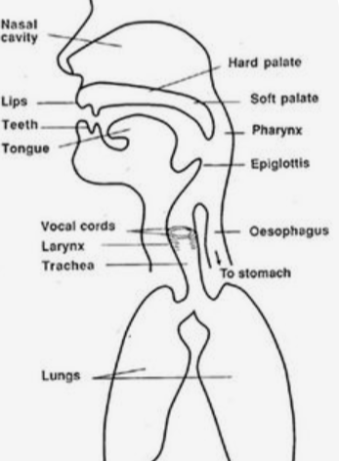
Effective voice usage
Posture + breath + resonance = voice
Keep the neck area relaxed
String at the back of your head
Don’t project with your chin
Warm up your voice
Try some tongue twisters!

Slide 25
Effective voice usage
Tone – more pronounced than feels natural
Pace – slower than feels normal
Volume – quieter than you think
Pitch – relax neck to lower
Emphasis – creates a focus on key words
Breathe – surprisingly easy to forget!

Slide 26
Taking care of your voice
Use non verbal forms of communication
Keep routines silent
Use gestures/resources/sounds to get attention
Watch for a feeling of tension
Don’t ‘squeeze’ your larynx
www.voicecare.org

Slide 27
Taking care of your voice
Drink water throughout the day
Avoid too much dairy/milk
Swallow, rather than cough, to clear voice
Take breaks from talking during the day
If you have concerns, consult your GP

Slide 28
6. Behaviour and Classroom Management

Slide 29
Approaches to behaviour
Behaviourist: systems, rewards, sanctions, manage behaviours
Restorative: dialogic, relational, change behaviours rather than manage

Slide 30
Behaviour: Key principles
Behaviour is a learning process not an end in itself: behaviour is about learning (for you/the students)
Be clear what you need – pre-empt issues, be proactive, rather than reactive
Give focus and energy to those ‘doing the right thing’
Aim to build relationships – put ‘credit’ in the bank
Consider: what’s missing? Self-regulation, empathy, language, attachment, physical needs …

Slide 31
Behaviour: What to Do
Clarity of Expectations
Confidence of Communication
Relationship Building

Slide 32
Behaviour: What to Do
Remember: it’s about the learning
Pre-empt the Problem
Verbal and Non Verbal

Slide 33
The Best Motivators …
Unexpected, unusual, creative, ironic
Reflect staff/learner relationships
Funny
A surprise!
Earned through co-operation
About the giving of time, attention, kindness
About social skills, as well as academic
Seen and noted by other adults/learners
Come from the learning - intrinsic over extrinsic
Not always given publicly

Slide 34
What supports self-regulation?
Attachment to a trusted adult
Reliable availability of resources
Agency – control over self/world
High levels of intellectual/physical challenge

Slide 35
From co-regulation to self-regulation
Routines = security
Agency within routines
Interacting or interfering?
‘You can do it’
Reassurance and take up time

Slide 36
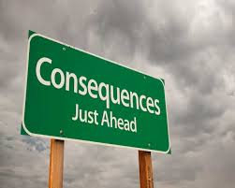
Behaviour: What Not to Do
Instinctive reactions
Rhetorical questions
Straight to consequences
Whole class punishments
Public displays of disapproval
Shaming/shouting

Slide 37
Thinking classroom management
Routines
Which bits can they do independently?
How can I offer them agency in this?
Teaching
When are issues most likely to arise?
How can I pre-empt them?
Handling Resources
What could potentially go wrong?
How will the children react to them?

Slide 38
7. The ECF and the Teachers’ Standards

Slide 39
https://www.gov.uk/government/publications/early-career-framework

Slide 40
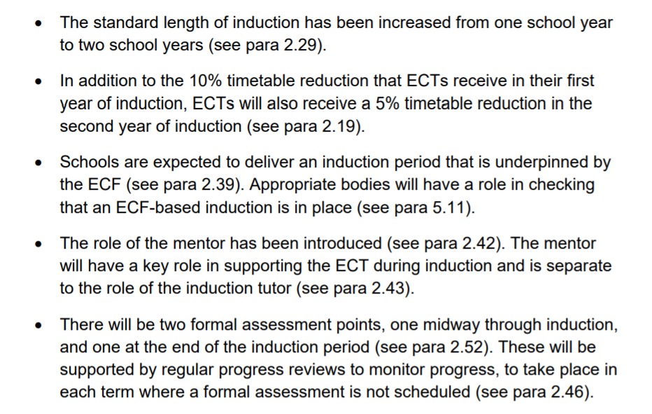
https://www.gov.uk/government/publications/induction-for-early-career-teachers-england

Slide 42
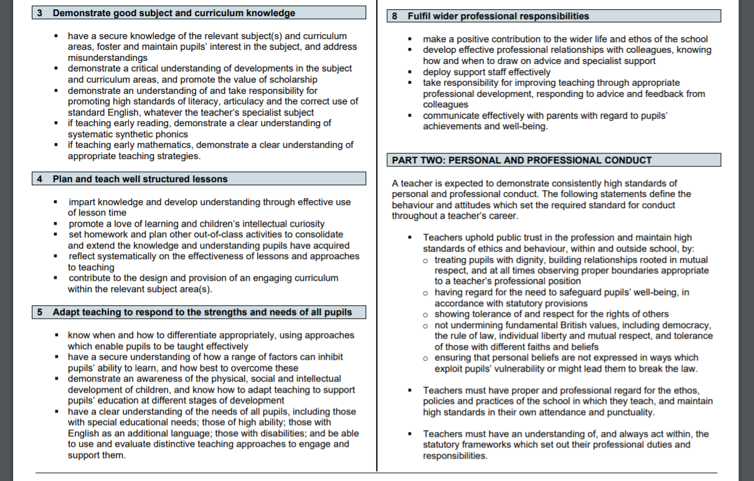

Slide 43
Any Questions?

