Slide 1
Creating a Curriculum in the Early Years Welcome! You’re in the right place This event will start at 4.00pm www.suecowley.co.uk sue@suecowley.co.uk @Sue_Cowley

Slide 2
What do we mean by
‘curriculum’ in the early years?

Slide 3
Curriculum in the early years is not subject-based
Early years is about children’s
Learning – Development – Care

Slide 4
There is significant pressure on settings in England to move away from a ‘developmentally appropriate’ approach to the phase
Practitioners need to hold tight to best practice/their values
The children can’t speak up so we need to stand between them and poor policy making

Slide 5
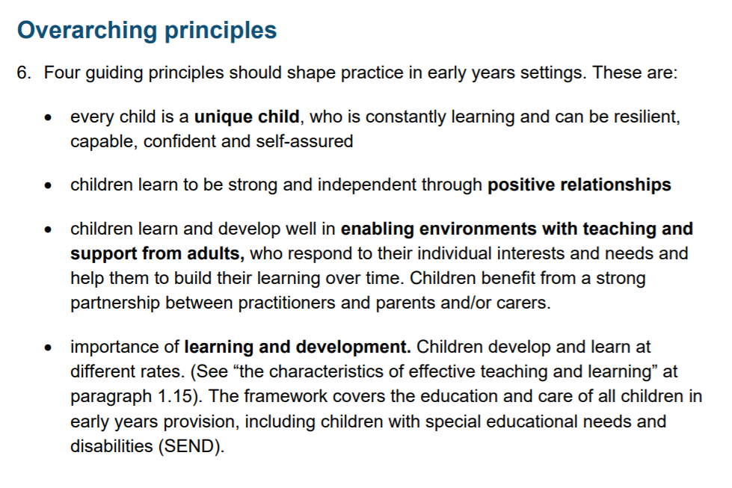

Slide 6
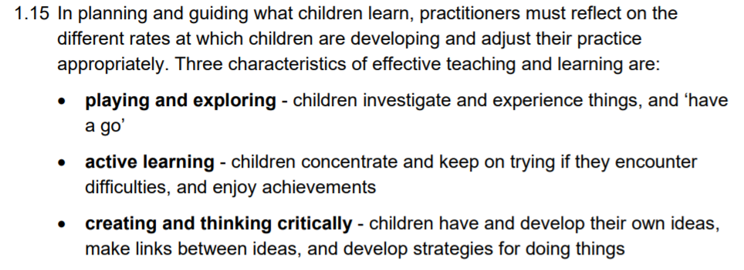

Slide 7
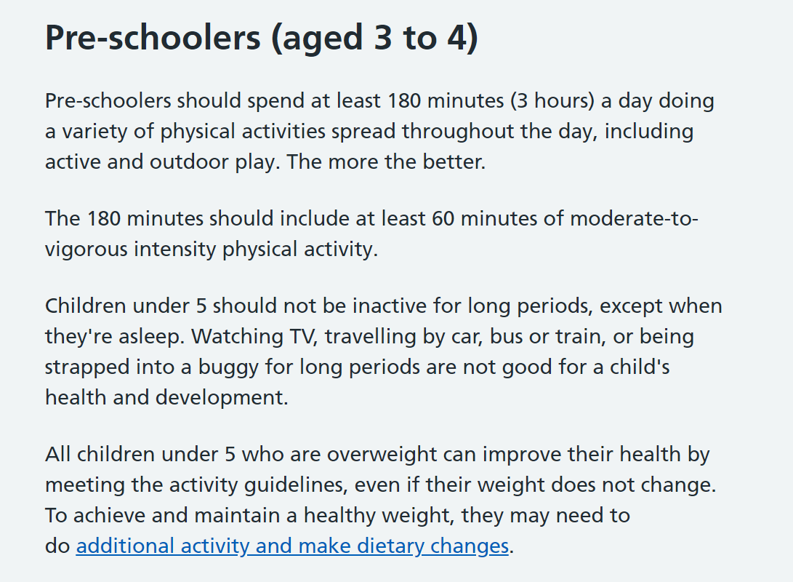

Slide 8
How can I design/explain my curriculum in the early years?
Thinking through the options …

Slide 9
You already have a curriculum
Your curriculum is made up of everything you choose to do for the benefit of the children’s care, learning and development
So what you need to do now is to figure out how to explain it to others!

Slide 10
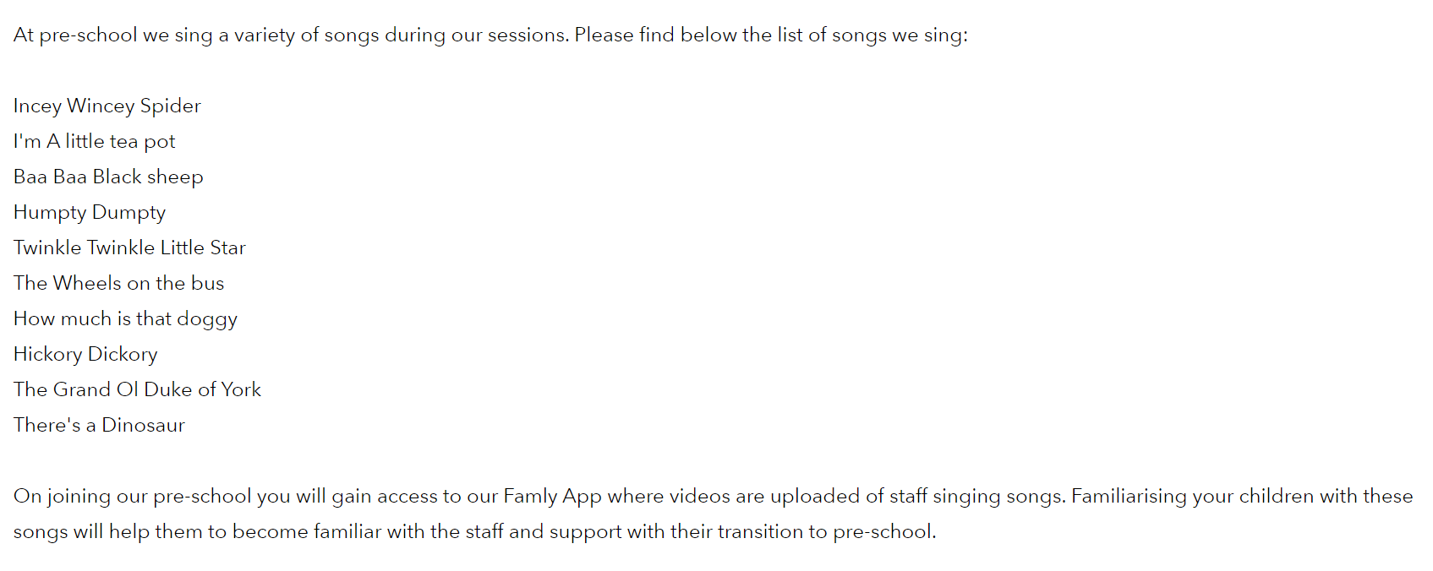
What Is 'My Curriculum’?
Think of three things that you do, that you would say make your setting *your setting*
For our setting, this would be:
Makaton
Forest Club
Nursery Rhymes

Slide 11
What would your ‘three things’ be? Tell me in the chat box You will probably notice that these ‘three things’ link really closely to your values and ethos – they are embedded

Slide 12
Now think about what your children know and can do as a result You will probably notice that many of these are not ‘facts’ but attitudes and aptitudes – this is fine! This is early years and early child development in a nutshell

Slide 13
What Is 'My Curriculum’?
Talk as a staff team about:
WHY do we do these things? (intent)
HOW do we put these things in place? (implementation)
HOW do we know they ‘work’? (impact)

Slide 14
What Is 'My Curriculum’?
For instance, Makaton:
WHY do we do these things? We use Makaton to develop communication/support inclusion.
HOW do we put these things in place? Staff training; use daily throughout the day and with stories/nursery rhymes; send to parents.
HOW do we know they ‘work’? Children’s knowledge of signs improves over time; signs aid communication, especially for children with SEND; strong perception locally that our setting is ‘inclusive’; feedback from parents.

Slide 15
What Is 'My Curriculum’?
NB: This is not static – it can and should change in response to the children’s needs
For instance, we are currently looking at moving from Makaton to BSL, in response to specific needs
Curriculum is a living, breathing thing, built from the ground up by staff, children and parents/carers – it is responsive and flexible

Slide 16
What Is 'My Curriculum’? Think your Way through your Day!
Another way to think about your curriculum is to think about what your provision is like
How do you adapt for children’s needs/interests?
What is your daily routine? Why do you do this?
What do you set out? Why have you chosen these resources? What is being learned?
What do children know/what can children do/what do children have as a result of your decisions?

Slide 17
What Is 'My Curriculum’? Think your Way through your Day!
Arrival routine
Morning carpet time
Freeflow
Snack time
Freeflow
Lunch time
Small group activities
Freeflow
Home time

Slide 18
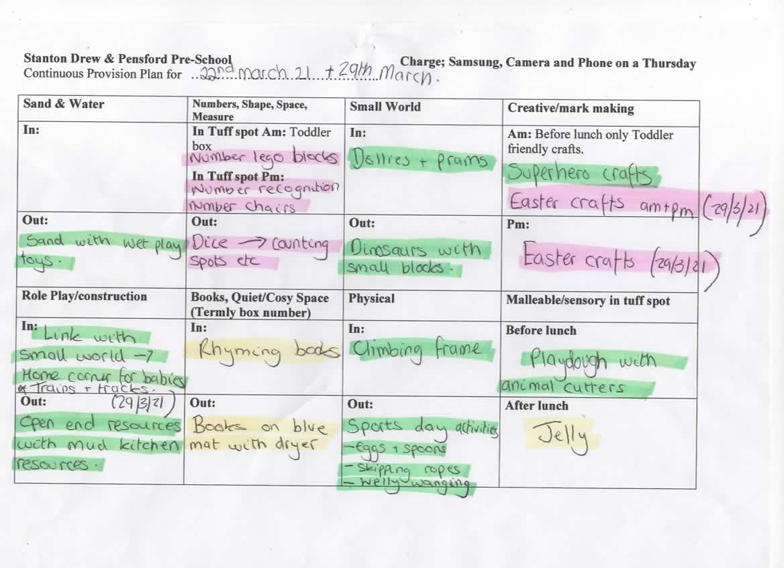
What Is 'My Curriculum’?

Slide 19
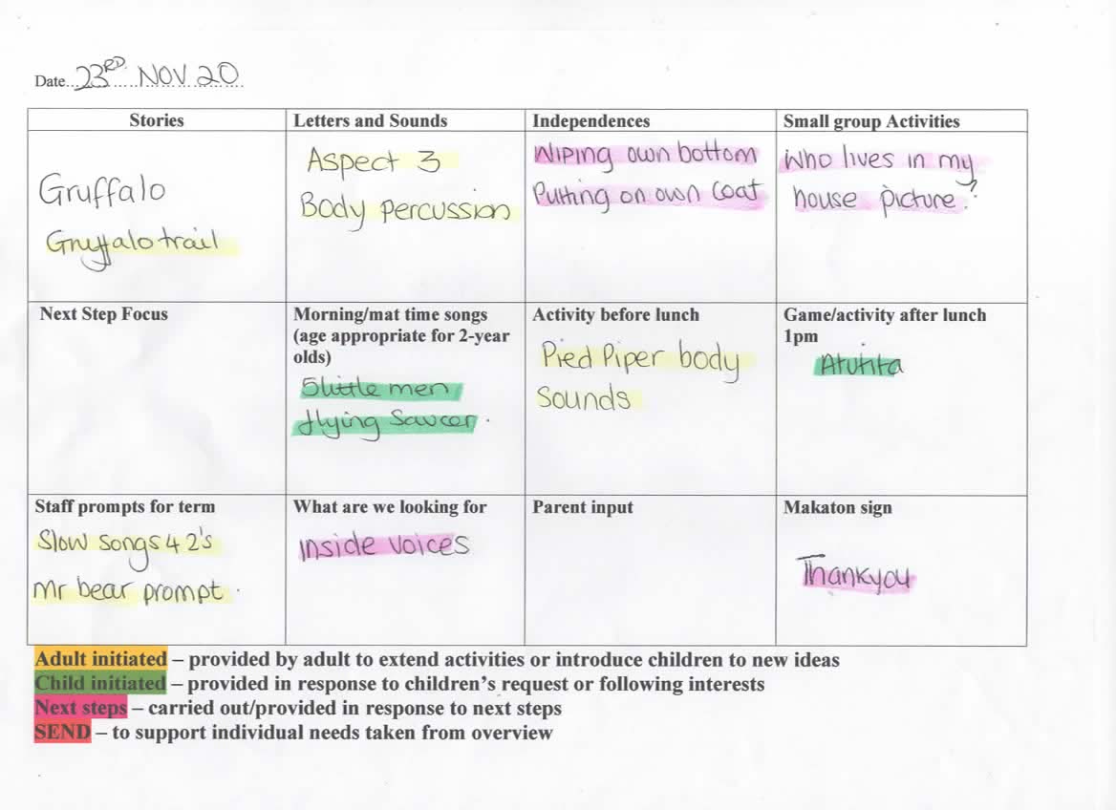
What Is 'My Curriculum’?

Slide 20
What Is 'My Curriculum’? Starting with the EPs
Another way to think about your curriculum is to start with the educational programmes
Think specifically about how you meet the requirements of the EPs – gather examples
Don’t just think about learning/play activities – consider all parts of your daily routine
Remember this is not a subject-based approach – you will cover several EPs with one activity

Slide 21
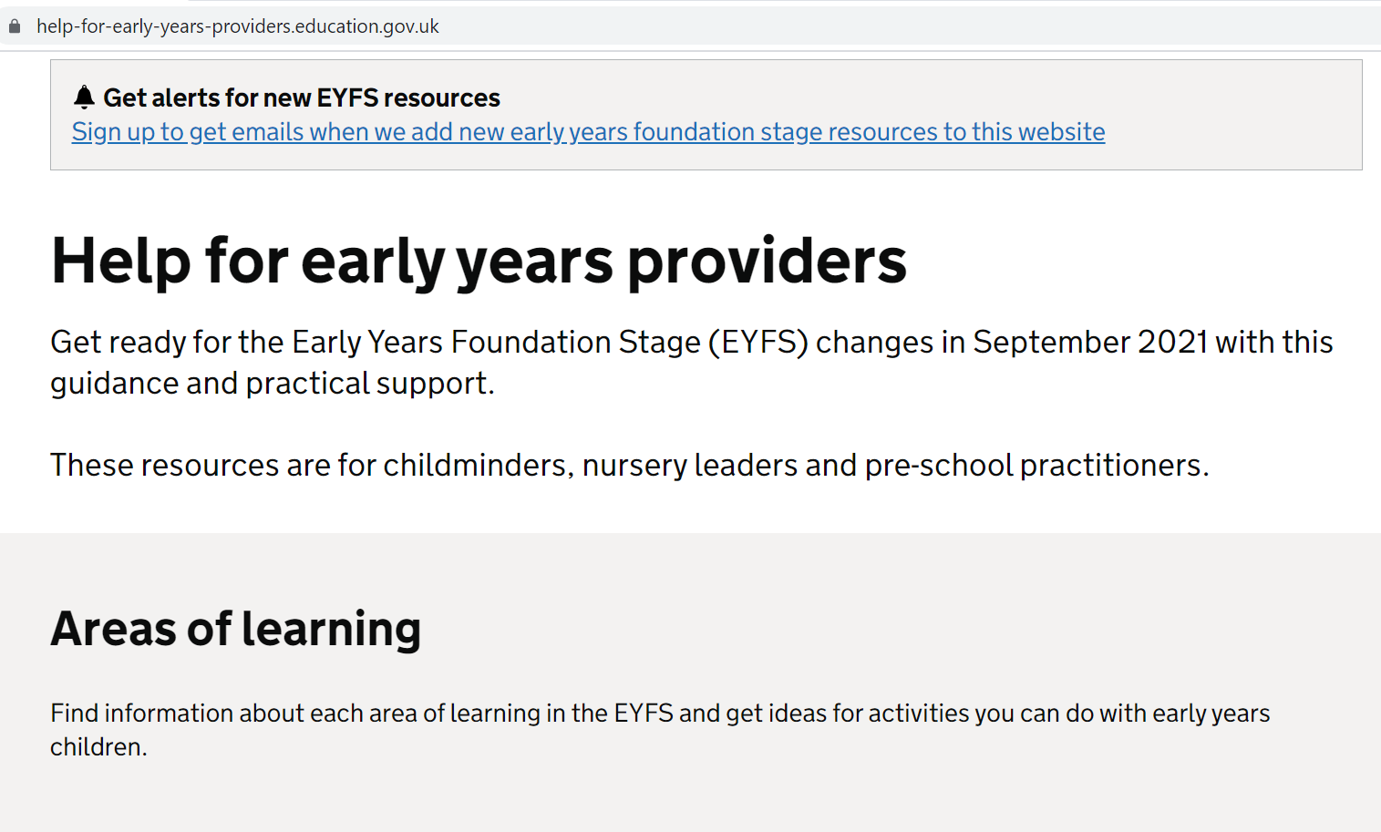
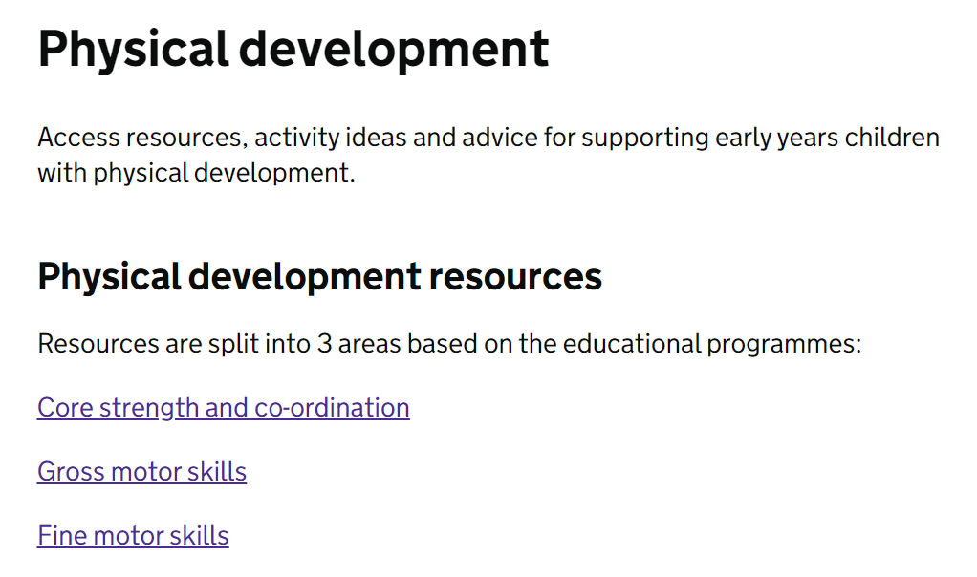
What Is 'My Curriculum’? Starting with the EPs

Slide 22
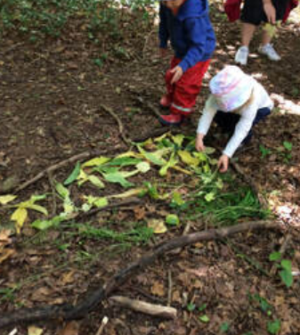
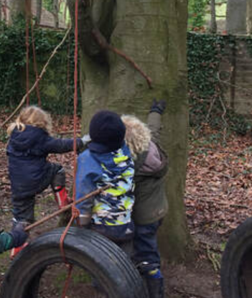
What Is 'My Curriculum’?

Slide 23
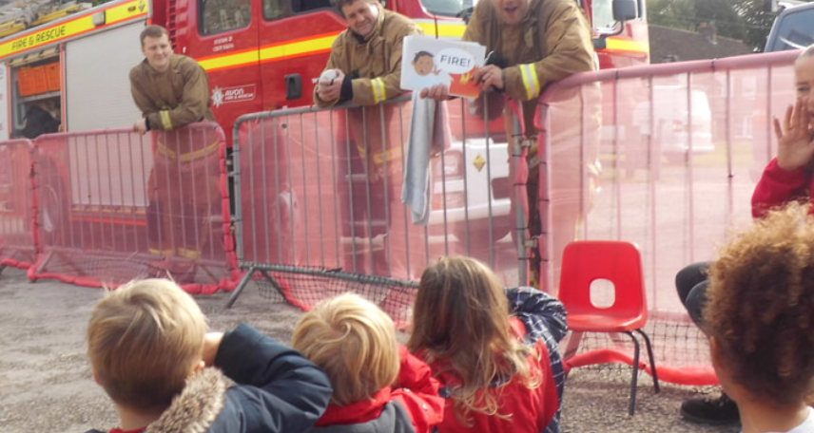
What Is 'My Curriculum’?

Slide 24
What Is 'My Curriculum’? Thinking Concepts; Linking Concepts
A really good way to link EY to later learning is to consider the foundational concepts you teach
These are concepts that later subject learning needs children to have in order to build upon
Remember: all subjects might be included in a single activity, ‘areas of learning’ do not = NC
Remember: “all areas of learning are important and interconnected”

Slide 25
What Is 'My Curriculum’? Thinking Concepts; Linking Concepts
History: past/present/future, ‘how long ago’?
Geography: location, direction, distance, diverse environments, physical characteristics
Maths: numbers as a symbol = quantity, shapes, measurement, money as a way to mark value
Art: creating colours, contrasts, texture, form
PSHE: sharing, how to be a good friend, eat well
Science: forces, changing states, living creatures, seasons

Slide 26
What Is ‘My Curriculum’? Using a Resources Audit
Resources are more than just ‘stuff’
They form the heart of your curriculum offer:
Audit your resources regularly
Talk together about why they are important to you
Discuss open-ended ways to use them in CP
Talk about what the children learn from them
Challenge yourself over representation/equity
Build on children’s learning by introducing them

Slide 27
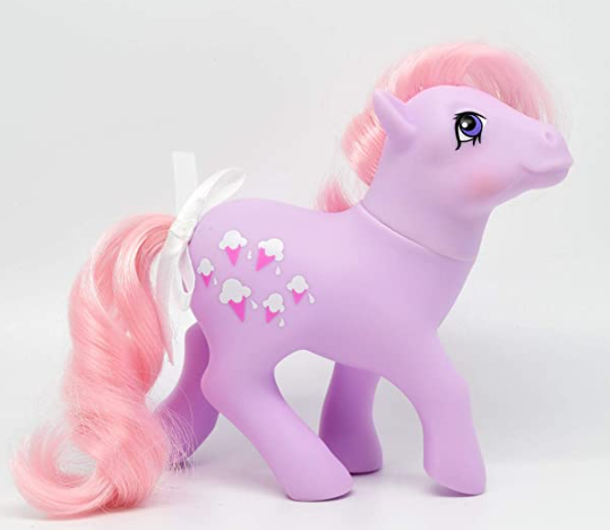
The Story of the Pink Ponies

Slide 28
What is Your ‘Pink Ponies’ Resource?

Slide 29
What Is 'My Curriculum’? When Ofsted Visit …
Be ready to talk Ofsted through all this during the ‘Learning Walk’
Be confident – this is your provision, own it!
‘Talk the talk’
Use ‘buzz words’ if you want to
Don’t write things down if you don’t want to be asked about them

Slide 30
What Is 'My Curriculum’? When Ofsted Visit …
The clear direction is not to ask for paperwork or data showing progress
Ofsted have said that you do not need a ‘long term plan’ on paper
However, schools are being asked to show how the KS1/2 curriculum ‘builds on’ EYFS
This should not mean that teachers are asked to ‘map’ provision onto the NC

Slide 31
What have Ofsted said?

Slide 32
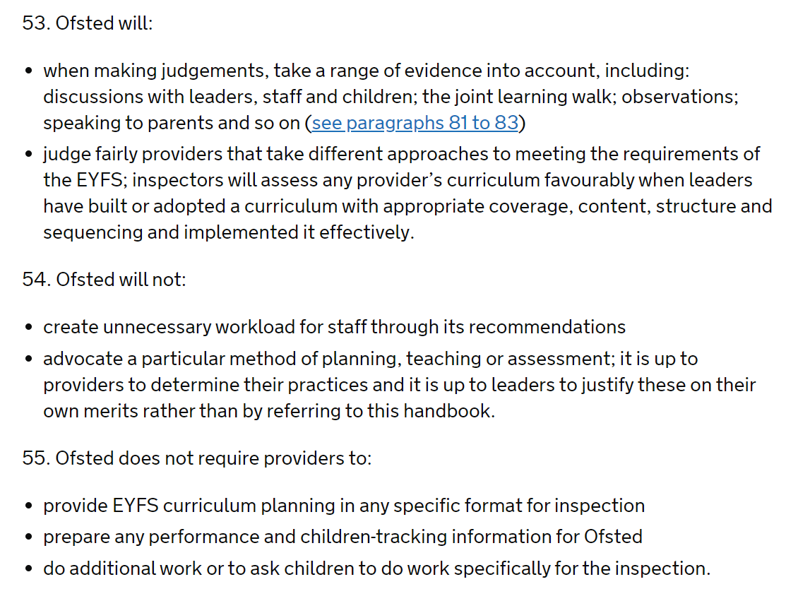
*Lodge an immediate informal complaint if you are asked for curriculum paperwork*

Slide 33
What do we need to consider about
‘curriculum’ in the early years?

Slide 34
Thinking About the Prime Areas
Everything you do in your setting will support the development of the prime areas
Serve and return conversations, warm relationships and lots of outdoor activity are all important for these
A lot of these are things that you can’t ‘write down’ in some kind of long term plan, but are about team work and self-reflection on provision

Slide 35
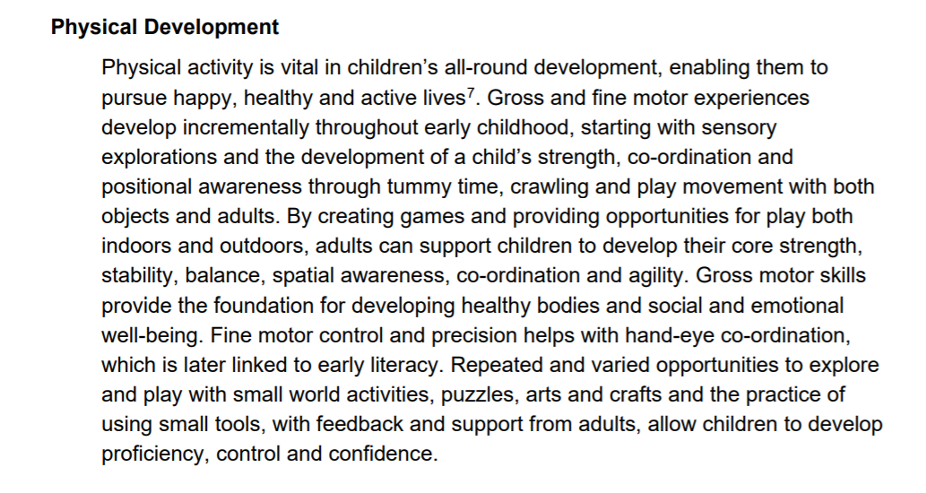
Thinking About the Prime Areas Where does PD happen in your Setting?

Slide 36
In The Moment versus Topics
No right/wrong answer!
The choice you make can relate to staff confidence and experience
You can ‘pick and mix’ to match the two
Be confident in the approach that you choose and reflective about it

Slide 37
In The Moment Planning
Hard to write down
Coverage can be an issue
Needs staff confidence
Flexible and responsive
Tends to be open-ended
Good for mixed age
Can boost challenge

Slide 38
Topic Based Planning
Can narrow opportunities
Can limit staff challenge
May not relate to interests
Something to ‘show’ visitors
More in line with DfE
Introduce new ideas
Can boost confidence

Slide 39
Co-Creating your Curriculum
Don’t think of curriculum as something that ‘has to be’ written down ahead of time
So often, learning in EYFS is spontaneous and accidental/incidental
Your plan for Continuous Provision gives a ‘map’ – the children decide on the journey
Other evidence might include blogs, LJs, displays, plans for CP, floor books

Slide 40
Co-Creating your Curriculum
The Educational Programmes essentially define what your curriculum needs to do
The ELGs are an end of stage measure
There is a lot of flexibility – you could meet all the EPs in a thousand different ways
The ‘best’ results arise out of well trained staff, flexibly managed, working effectively as a team

Slide 41
What’s Happening in Reception?
Different handbook to PVI
Strong focus on literacy and SSP – ‘from the start’ of Reception including ‘deep dive’
Seems to be evidence of an drive to make Reception ‘more like KS1’
Some teachers being asked to ‘map’ the EYFS onto the NC/to create ‘skills progression maps’

Slide 42
How can I map my
curriculum in the early years?

Slide 43
What Could My ‘Map’ Look Like?
Key aspects of your provision
Care, learning and development
List of key texts, songs, concepts, vocabulary
Resources audit
Continuous provision planning
For Yr.R, NC should build on EYFS, not just EYFS linking to pre-existing NC content

Slide 44
Creating a Curriculum: Talking Points
What things do we do that make us ‘us’?
How do we map our continuous provision?
How do we know what the children need next?
How do we identify the progress children make?

Slide 45
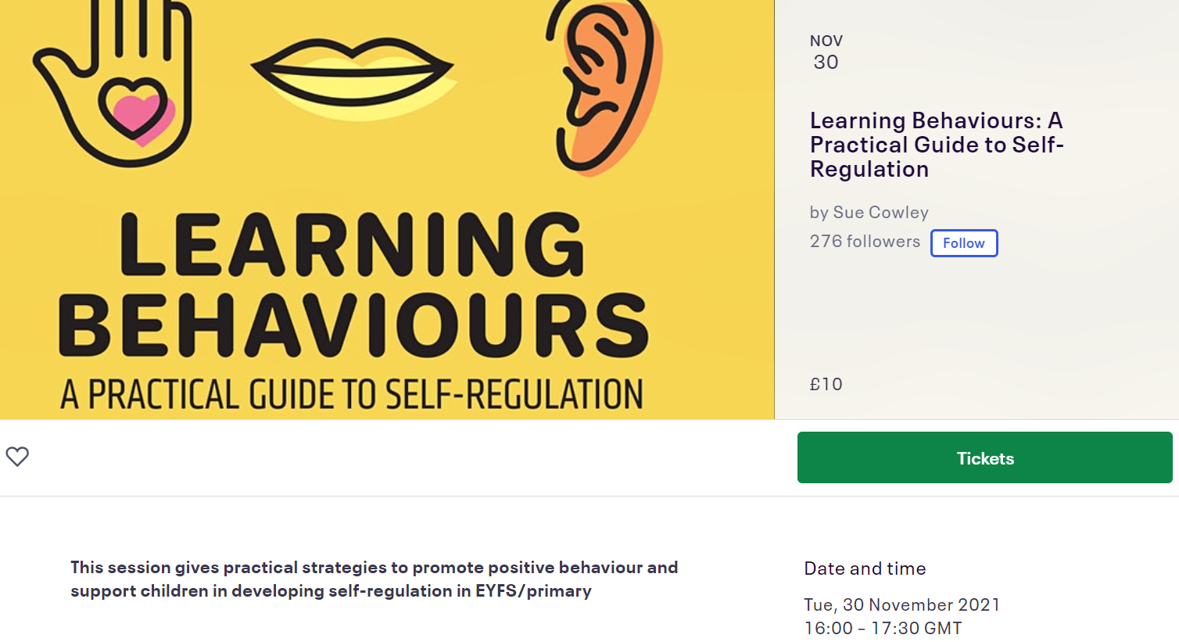
If you enjoyed this session, you might also like:
https://www.eventbrite.co.uk/e/learning-behaviours-a-practical-guide-to-self-regulation-tickets-204964954697

Slide 46
Any Questions?

