Slide 1
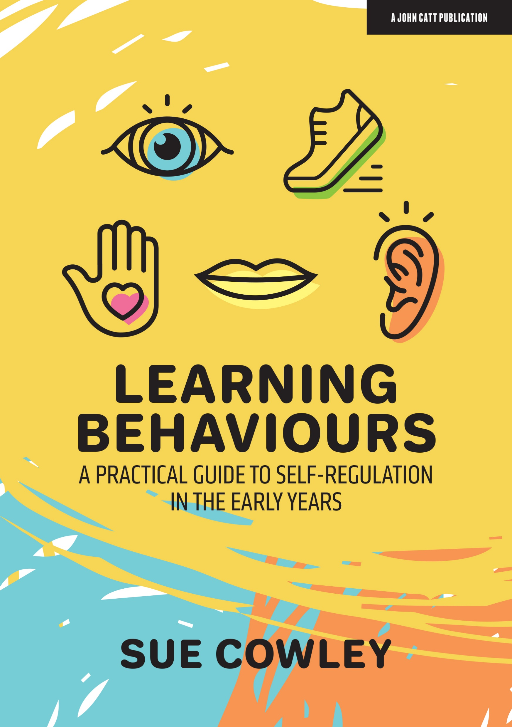

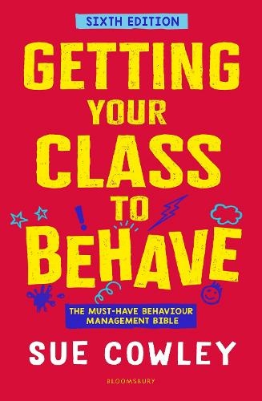
Positive approaches to behaviour
Supporting the Development of Self-Regulation
Contact details:
www.suecowley.co.uk
sue@suecowley.co.uk
@Sue_Cowley

Slide 2
Outline of the day
9.00am – 10.30am
Session One: Key Principles of Positive Behaviour Management
11.00am – 12.30pm
Session Two: A Practical Guide to Self-Regulation
1.15pm – 2.15pm
Session Three: Marshmallows and Traffic Cops – Managing Motivation
2.30pm – 3.15pm
Session Four: Action Planning – Next Steps

Slide 3
Key principles
Behaviour is a learning process not an end in itself: behaviour is about learning (for teachers/children)
Be clear what you need – pre-empt issues and be proactive, rather than reactive
Give focus and energy to the learners who are ‘doing the right thing’
Aim to build relationships – put ‘credit’ in the bank – inside and outside the classroom

Slide 4
Key principles
Consider: what learning is missing? Self-regulation, empathy, language, attachment, physical needs …
What skills do your learners still need to develop? Be proactive – ‘teach’ these behaviours
What can you do within the curriculum/school life to support the learning of these skills?
How can provision better meet learning needs?

Slide 5
Approaches to behaviour
Behaviourist: systems, rewards, sanctions, manage behaviours
Restorative: dialogic, relational, change behaviours rather than manage

Slide 6
Session One: Key Principles of Positive Behaviour Management

Slide 7
Confident communication
We know what behaviours we want
I look confident about getting the behaviours
I narrate the ‘why’

Slide 8
a Focus on the positive
I highlight what’s going right
“This is how we do it here.”
I use statements not rhetorical questions

Slide 9
building the ethos
I reinforce and revisit the rules
I model the expectations that I set
We create routines that embed ethos

Slide 10
Whole school Consistency
Staff act as a team on the approach
Rewards and consequences are carefully used
Everyone is clear about ethos/ expectations

Slide 11
Internal Consistency
I maintain consistent standards
I know how to get there in flexible ways
I am aware of my internal bias

Slide 12
flexible responses
Distract (e.g. volunteer tasks)
Defer (‘I’ll talk to you later’)
Defuse (e.g. take a moment ‘out’)

Slide 13
reasonable adjustments/send
Offer a choice rather than a demand
Warn about changes to routine – now/next
Understand the triggers and avoid them

Slide 14
supporting children who struggle with working memory
Exact, specific use of language – be literal
Explicit (not general ‘get ready to go home’)
Repeat and rephrase, adjusting vocabulary
Concrete examples of concepts
Gestures, visuals, diagrams, icons, charts
Chunk up instructions

Slide 15
effective communication
Self
I model self control
I know how to keep myself calm
Voice
I control my tone, pace, pitch and volume
I consider how I frame what I say
Body
I use space, levels, movement, eyes
I think about gesture and visuals

Slide 16
Framing for motivation – The language of Choice
I encourage the children to see their behaviour as their choice
I use the ‘language of choice’ when dealing with issues
I pre-empt issues to encourage good choices by thinking ahead

Slide 17
Session Two: A Practical Guide to Self-Regulation

Slide 18
What is Self-Regulation?
Executive function: working memory, mental flexibility, self-control
Be aware of, understand and manage own behaviours
Impulse control and deferred gratification

Slide 19
What is Self-Regulation?
Maintain focus, direct attention, manage distractions
Awareness of strong feelings, self-calming strategies
Empathy - seeing other perspectives

Slide 20
What is Self-Regulation?
Setting and achieving goals
Coping well with challenge and failure
‘Can do’ attitude – linked to sense of self

Slide 21
What Factors Support the development of Self-Regulation?
Attachment to a trusted adult
Reliable availability of resources
Agency – control over self/world
High levels of intellectual/physical challenge

Slide 22
What Factors Support the
Development of Self-Regulation?
Unconditional positive regard
Environmental and genetic factors
Sustained shared thinking (Siraj-Blatchford)
Links to language development – thinking through

Slide 23
Climbing muddy banks:
How Can We Co-Regulate?
Soothing, coaxing, supporting
Emotional supports – scaffolding
Warm and responsive interactions
Working together to help them regulate
Supporting/calming when dysregulated
Identify and discuss the emotions

Slide 24
From Co-Regulation to Self-Regulation
Routines = security
Agency within routines
Interacting or interfering?
‘You can do it’
Reassurance and take up time

Slide 25
Helping Children Develop Self-Regulation:
Behavioural Control
Support children to understand their behaviours
Narrate why some behaviours are problematic
What is my body doing? How can I control myself?

Slide 26
Helping Children Develop Self-Regulation:
Behavioural Control
Pre-empt issues – avoid triggering fear/panic
Aim to hand behaviour over to the children
Poor proprioception: jump, crash, grab, push
Proprioceptive input calms/organises the brain
‘Heavy work’: dig, pour, roll, cut, push, carry
Oral activities: chew, blow bubbles, balloons

Slide 27
Helping Children Develop Self-Regulation:
Emotional Control
Name the emotions – be explicit
Model the self-calming process
Promote empathy/other perspectives

Slide 28
Helping Children Develop Self-Regulation:
Emotional Control
Interoception: our responses to information from our body (vagus nerve) – interpreted as ‘feelings’
Sense of self – ‘how do I exist?’ – includes hunger, temperature, pain, affection
Am I hot or cold? Touch cheeks to find out
Give vocabulary – ‘is it a big or little hurt?’

Slide 29

Helping Children Develop Self-Regulation:
Emotional Control
Talk through feelings – be explicit
Where do I feel this? What is source or cause?
‘Name that feeling’ activities – Colour Monster
Teacher as a model – facial expressions, calm
Mindfulness activities for proprioception

Slide 30
Helping Children Develop Self-Regulation:
Emotional Control
Empathy: relatively late developing aspect
Need to be able to imaginatively reposition yourself into another person’s mind
Theory of Mind: understand that other people have their own minds
Empathy in the curriculum – ‘in someone else’s shoes’ – role play, stories, biographies

Slide 31
Helping Children Develop Self-Regulation: building resilience
Narrate the thinking processes
Offer comfort and support
But don’t be a helicopter!

Slide 32
Helping Children Develop Self-Regulation: building resilience
Stop, pause, observe: give ‘take up’ time – to children, to yourself
Risk assess but plan for challenge: what’s the worst that can happen?
Leave spaces to fail – don’t immediately repair issues for children
Help parents build children’s independence: give strategies – goal ladder/checklist

Slide 33
Helping Children Develop Self-Regulation: building impulse control
Look for chances to learn to wait
Pitch the level of challenge higher than you think
Always consider: who is doing the work?

Slide 34
Helping Children Develop Self-Regulation: building impulse control
The ‘Batman Effect’ – zoom out, separate from the situation (self-distancing)
The ‘ready ready’ game
Games for patience/waiting/freezing – Grandma’s footsteps, musical statues, board games
Curriculum activities that happen over time – growing, changes with the seasons

Slide 35
Helping Children Develop Self-Regulation: coping with challenge/failure
Praise agency rather than attainment
Give the child agency to repair mistakes
Trust: especially the hardest to trust

Slide 36
Helping Children Develop Self-Regulation: coping with challenge/failure
Teacher as model of failing well: say sorry!
Deliberate mistakes – learners to spot them
Don’t immediately ‘repair’ errors
‘Brag’ about errors – failure Fridays
Do fast activities – it’s okay to throw it away!
Volunteer tasks – ‘caring for’/community based ‘chores’

Slide 37
Where is Self-Regulation in our curriculum?
Morning routine – encouraging agency, emotional awareness, choices, independence
Carpet time – ‘find a mat’, attentional control, think through the day
Snack time routine – managing self, caring for others, interoceptive awareness
Move/still routines – imaginative contexts, timings and targets, ‘freezing’ bodies

Slide 38

Session Three: Marshmallows and Traffic Cops

Slide 39
Thinking about extrinsic motivators
Can elicit feelings of shame – especially if public
Potential to decrease intrinsic motivation and devalue the task
Can encourage fixed rather than growth mindset and a ‘what’s in it for me?’ mentality
Can be useful as a ‘marker’ or symbol of progress

Slide 40

The Best Motivators …
Unexpected, unusual, creative, ironic
Reflect staff/learner relationships
Funny
A surprise!
Earned through co-operation
About the giving of time, attention, kindness
About social skills, as well as academic
Seen and noted by other adults/learners
Come from the learning - intrinsic over extrinsic
Not always given publicly

Slide 41

Thinking about the NIKE learners
“Just Do It”

Slide 42
Why do some learners ‘just do it’?
Support from home, well parented
Naturally curious and interested in learning
Respect for (fear of) authority
Keen to please the teacher/adults
See the value of learning
Aiming for a long term goal, e.g. career
Enjoy working hard and being successful
See education as an escape route
Sibling rivalry – ‘keeping up with’ siblings
Love the particular subject
Inspired by a specific teacher or adult
Take pride in working neatly or well
Keen to earn rewards
Like to fit in and stay below the radar
Competitive – want to be the ‘best’

Slide 43
Why do some learners ‘just do it’?
How can we replicate those factors?
Support from home, well parented | Partnerships with parents, support for parents, nurture groups, breakfast clubs
Naturally curious and interested in learning | Show that learning is fun and engaging
Respect for (fear of) authority | Clear boundaries, visible, role models
Keen to please the teacher/adults | Discover what the individual child enjoys
See the value of learning | Show why something is being learned
Aiming for a long term goal, e.g. career | Bring in ex-pupils to talk about careers
Enjoy working hard and being successful | Set tough but achievable targets
See education as an escape route | Make school an ‘oasis’
Rivalry – ‘keeping up with’ peers/siblings | An element of competition (against self?)
Love the particular subject | Inspire them to love it: rediscover curiosity
Inspired by a specific teacher or adult | Analyse ‘inspirational’. Find a way to ‘click’
Take pride in working neatly or well | Displays, highlight examples, use ICT
Keen to earn rewards | Use rewards that they really want
Like to fit in and stay below the radar | Calm working atmosphere
Competitive – want to be the ‘best’ | Group competitions, compete against self

Slide 44
teaching/learning and motivation
Focus on what we can *change* to maintain motivation
Behaviour as part of learning – ‘teach’ behaviours
Build on interests to create engagement
Develop learner voice and ownership

Slide 45
framing for motivation
– using examples
Stories and narratives are powerful
Connect to prior experiences; provide new experiences
Consider learner interests and how to incorporate

Slide 46
Teaching for motivation: the role of Creativity
I question and adapt my approaches – I am reflective
I take risks and try things from ‘left field’
I use active, multi-sensory approaches
Abstract concepts: concrete examples

Slide 47
Session Four: Action Planning – Next Steps

Slide 48
Checklist for change
Strengths:
…………………………………………………….
…………………………………………………….
…………………………………………………….
…………………………………………………….
…………………………………………………….

Slide 49
Checklist for change
Targets for development:
…………………………………………………….
…………………………………………………….
…………………………………………………….
…………………………………………………….
…………………………………………………….

Slide 50
Checklist for change
What will I need? Support/resources/timing
…………………………………………………….
…………………………………………………….
…………………………………………………….
…………………………………………………….
…………………………………………………….

